Slide 1
Local AI with CoreML and TensorFlow Lite - and More!
@ray_deck

Slide 3
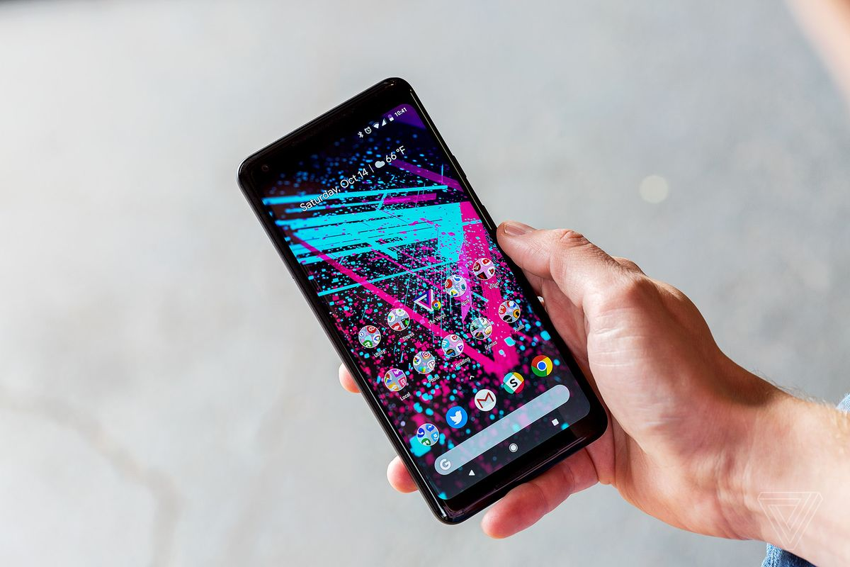
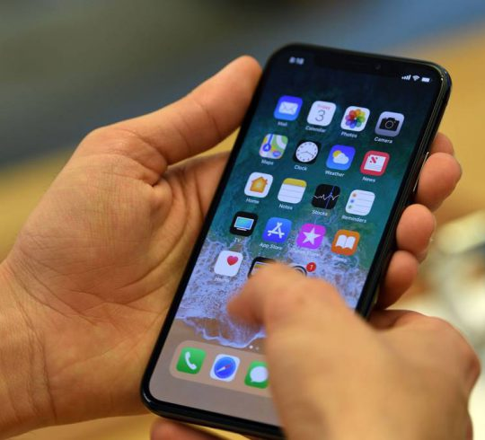

Slide 4
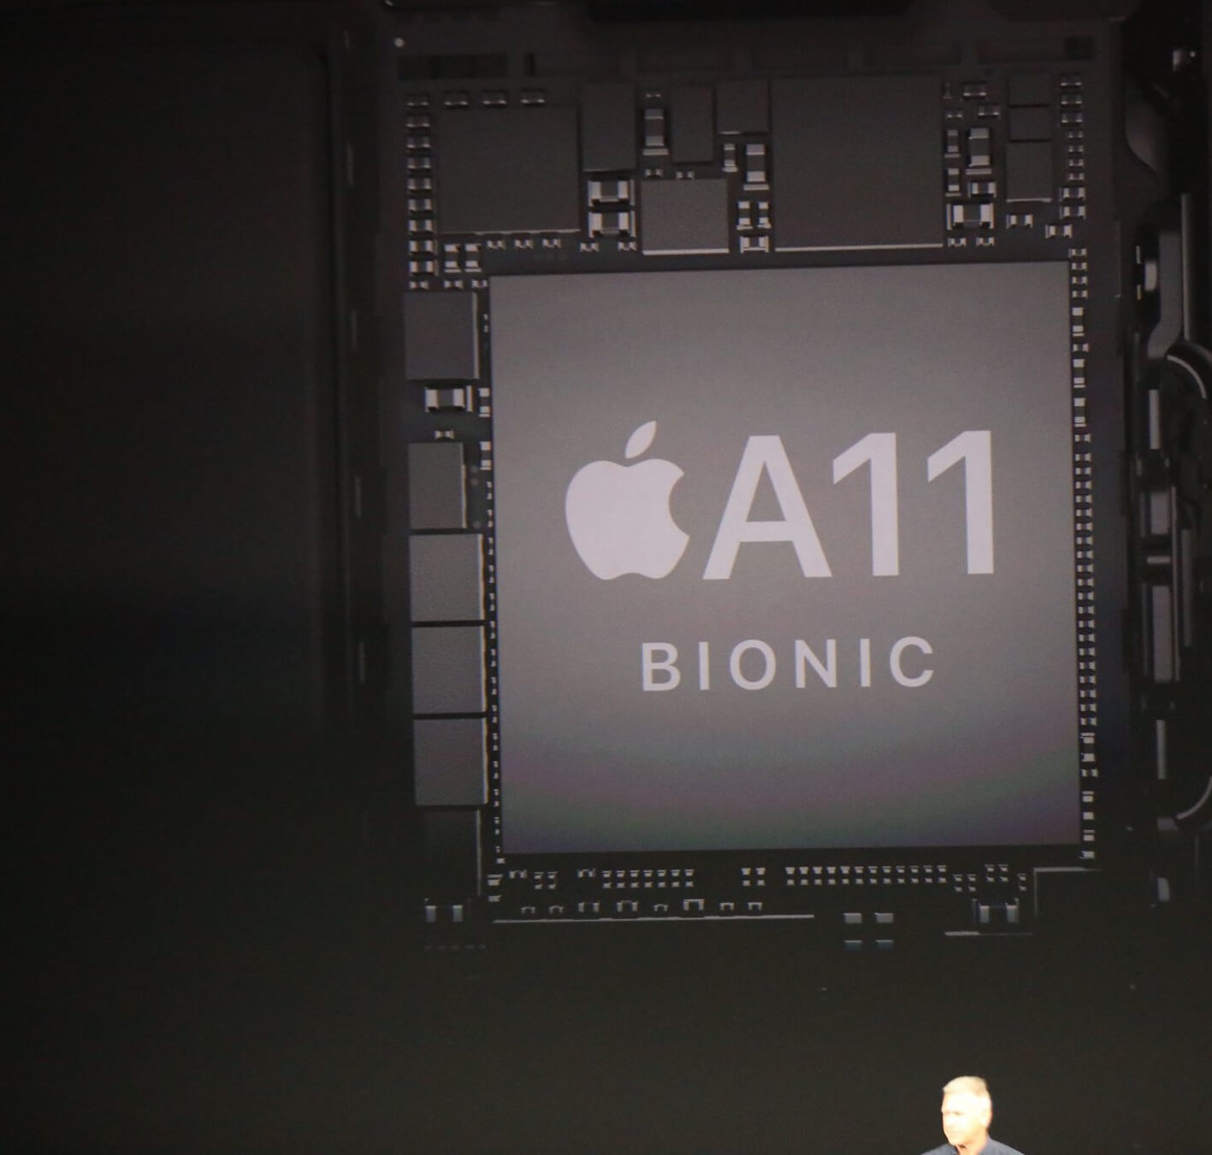
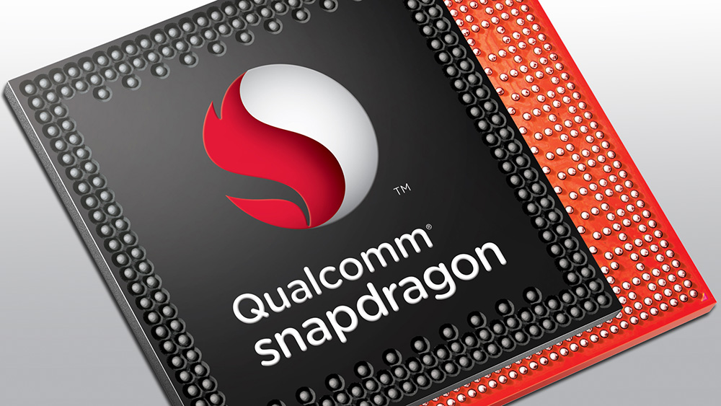

Slide 5
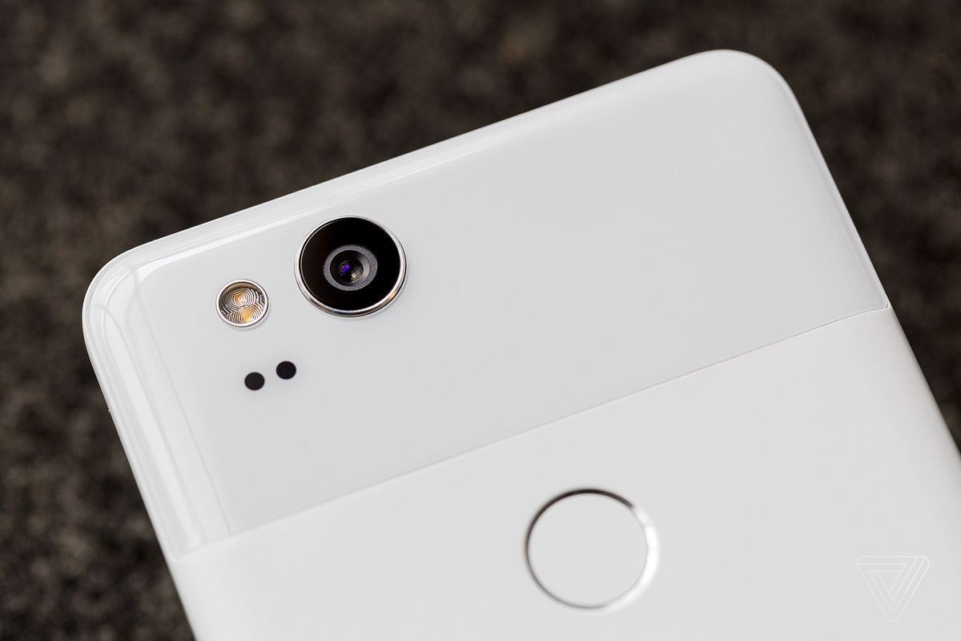
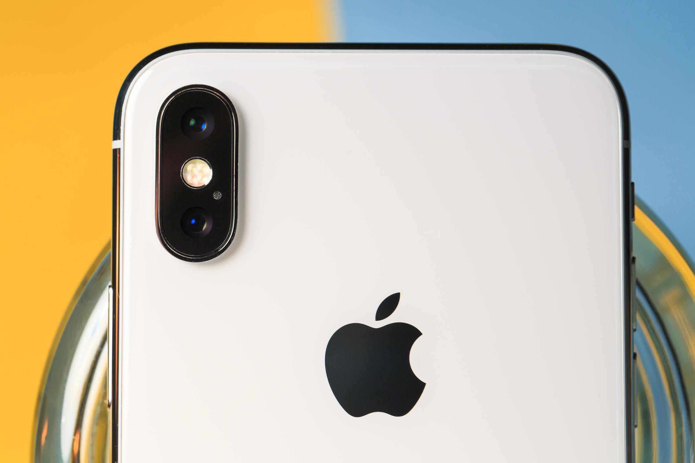

Slide 7
Artificial Intelligence Statistical Computing Machine Learning Stochastic Programming

Slide 8
Functions Written by Machines

Slide 9
Supervised Learning Transfer Learning Reinforcement Learning Adversarial Networks

Slide 10
y = f(x)

Slide 11
= f( )
0.1489
0.0026
0.0128
0.0731
0.1212
0.0933
0.0110
0.0011
0.0432
0.0002
0.0299
0.0054
0.0255
0.0035
0.1043
0.1407
0.0958
0.0060
0.0008
0.0417
0.0002
0.0389
0.3200 | 0.5421 | 0.5110 | 0.7389 | 0.4918 | 0.9184
0.8660 | 0.3020 | 0.4890 | 0.6987 | 0.3051 | 0.4029
0.0722 | 0.6375 | 0.7953 | 0.1546 | 0.2867 | 0.9654
0.3608 | 0.6891 | 0.8220 | 0.0024 | 0.2030 | 0.1865
0.6227 | 0.2532 | 0.9418 | 0.8587 | 0.0778 | 0.5965
0.1612 | 0.2107 | 0.1784 | 0.5981 | 0.5417 | 0.3071
0.2835 | 0.8236 | 0.3139 | 0.1868 | 0.7756 | 0.1203
0.5113 | 0.8758 | 0.0920 | 0.9075 | 0.1681 | 0.7669
0.6540 | 0.9847 | 0.2407 | 0.0232 | 0.4423 | 0.8521
0.1045 | 0.6293 | 0.9488 | 0.3950 | 0.5043 | 0.7875
0.0377 | 0.1511 | 0.6241 | 0.1502 | 0.2732 | 0.9331
0.2222 | 0.6622 | 0.5402 | 0.7650 | 0.1721 | 0.3517
0.4795 | 0.8597 | 0.4049 | 0.7070 | 0.0784 | 0.6631
0.3131 | 0.7966 | 0.4261 | 0.7823 | 0.7319 | 0.0807
0.2659 | 0.7687 | 0.7874 | 0.8179 | 0.0292 | 0.4352
0.4201 | 0.2091 | 0.2931 | 0.3404 | 0.4661 | 0.6139
0.3099 | 0.1022 | 0.0893 | 0.3600 | 0.8400 | 0.5494
0.0287 | 0.7979 | 0.6785 | 0.1231 | 0.0385 | 0.0082
0.5974 | 0.5917 | 0.1183 | 0.8901 | 0.9990 | 0.8012
0.7279 | 0.8426 | 0.2705 | 0.7502 | 0.9465 | 0.5517
0.9324 | 0.1228 | 0.4561 | 0.0281 | 0.7467 | 0.2544
0.9296 | 0.9581 | 0.9300 | 0.1107 | 0.0081 | 0.5787
0.0548 | 0.6564 | 0.0637 | 0.5374 | 0.1792 | 0.4786
0.3202 | 0.4883 | 0.9120 | 0.7424 | 0.8177 | 0.8120
0.8694 | 0.7283 | 0.8922 | 0.2756 | 0.9849 | 0.4665
0.2098 | 0.9957 | 0.5271 | 0.7638 | 0.4820 | 0.9617
0.2385 | 0.8299 | 0.3855 | 0.9500 | 0.3676 | 0.2845
0.1923 | 0.7167 | 0.6323 | 0.9345 | 0.2605 | 0.0331
0.5322 | 0.1652 | 0.4930 | 0.2563 | 0.5717 | 0.1103
0.7212 | 0.4764 | 0.9196 | 0.6196 | 0.4345 | 0.6993
0.8939 | 0.5753 | 0.7510 | 0.1955 | 0.7078 | 0.9869
0.9766 | 0.7216 | 0.0188 | 0.8569 | 0.8033 | 0.7709
0.3885 | 0.6761 | 0.4612 | 0.8000 | 0.8435 | 0.8812

Slide 12
Computer Vision Image Classification Natural Language Processing

Slide 13


VisionKit MLKit/Vision
Tesseract OCR

Slide 14
CoreML TF Lite
Caffe2

Slide 15
File Specification Runtime

Slide 16
Privacy Performance Personalization

Slide 19
Reality is Declarative

Slide 20
react-native-coreml react-native-tesseract-ocr react-native-vision

Slide 21
Make the World Your Provider

Slide 23
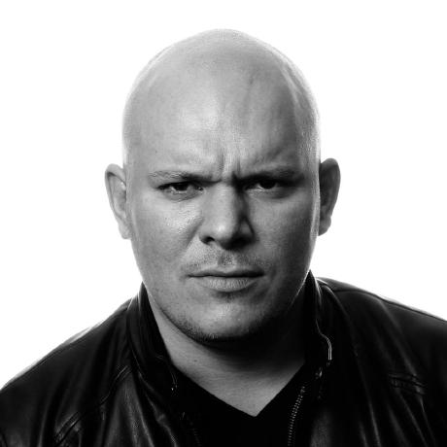
0.3200 | 0.5421 | 0.5110 | 0.7389 | 0.4918 | 0.9184
0.8660 | 0.3020 | 0.4890 | 0.6987 | 0.3051 | 0.4029
0.0722 | 0.6375 | 0.7953 | 0.1546 | 0.2867 | 0.9654
0.3608 | 0.6891 | 0.8220 | 0.0024 | 0.2030 | 0.1865
0.6227 | 0.2532 | 0.9418 | 0.8587 | 0.0778 | 0.5965
0.1612 | 0.2107 | 0.1784 | 0.5981 | 0.5417 | 0.3071
0.2835 | 0.8236 | 0.3139 | 0.1868 | 0.7756 | 0.1203
0.5113 | 0.8758 | 0.0920 | 0.9075 | 0.1681 | 0.7669
0.6540 | 0.9847 | 0.2407 | 0.0232 | 0.4423 | 0.8521
0.1045 | 0.6293 | 0.9488 | 0.3950 | 0.5043 | 0.7875
0.0377 | 0.1511 | 0.6241 | 0.1502 | 0.2732 | 0.9331
0.2222 | 0.6622 | 0.5402 | 0.7650 | 0.1721 | 0.3517
0.4795 | 0.8597 | 0.4049 | 0.7070 | 0.0784 | 0.6631
0.3131 | 0.7966 | 0.4261 | 0.7823 | 0.7319 | 0.0807
0.2659 | 0.7687 | 0.7874 | 0.8179 | 0.0292 | 0.4352
0.4201 | 0.2091 | 0.2931 | 0.3404 | 0.4661 | 0.6139
0.3099 | 0.1022 | 0.0893 | 0.3600 | 0.8400 | 0.5494
0.0287 | 0.7979 | 0.6785 | 0.1231 | 0.0385 | 0.0082
0.5974 | 0.5917 | 0.1183 | 0.8901 | 0.9990 | 0.8012
0.7279 | 0.8426 | 0.2705 | 0.7502 | 0.9465 | 0.5517
0.9324 | 0.1228 | 0.4561 | 0.0281 | 0.7467 | 0.2544
0.9296 | 0.9581 | 0.9300 | 0.1107 | 0.0081 | 0.5787
0.0548 | 0.6564 | 0.0637 | 0.5374 | 0.1792 | 0.4786
0.3202 | 0.4883 | 0.9120 | 0.7424 | 0.8177 | 0.8120
0.8694 | 0.7283 | 0.8922 | 0.2756 | 0.9849 | 0.4665
0.2098 | 0.9957 | 0.5271 | 0.7638 | 0.4820 | 0.9617
0.2385 | 0.8299 | 0.3855 | 0.9500 | 0.3676 | 0.2845
0.1923 | 0.7167 | 0.6323 | 0.9345 | 0.2605 | 0.0331
0.5322 | 0.1652 | 0.4930 | 0.2563 | 0.5717 | 0.1103
0.7212 | 0.4764 | 0.9196 | 0.6196 | 0.4345 | 0.6993
0.8939 | 0.5753 | 0.7510 | 0.1955 | 0.7078 | 0.9869
0.9766 | 0.7216 | 0.0188 | 0.8569 | 0.8033 | 0.7709
0.3885 | 0.6761 | 0.4612 | 0.8000 | 0.8435 | 0.8812

Slide 24
0.3200 | 0.5421 | 0.5110 | 0.7389 | 0.4918 | 0.9184
0.8660 | 0.3020 | 0.4890 | 0.6987 | 0.3051 | 0.4029
0.0722 | 0.6375 | 0.7953 | 0.1546 | 0.2867 | 0.9654
0.3608 | 0.6891 | 0.8220 | 0.0024 | 0.2030 | 0.1865
0.6227 | 0.2532 | 0.9418 | 0.8587 | 0.0778 | 0.5965
0.1612 | 0.2107 | 0.1784 | 0.5981 | 0.5417 | 0.3071
0.2835 | 0.8236 | 0.3139 | 0.1868 | 0.7756 | 0.1203
0.5113 | 0.8758 | 0.0920 | 0.9075 | 0.1681 | 0.7669
0.6540 | 0.9847 | 0.2407 | 0.0232 | 0.4423 | 0.8521
0.1045 | 0.6293 | 0.9488 | 0.3950 | 0.5043 | 0.7875
0.0377 | 0.1511 | 0.6241 | 0.1502 | 0.2732 | 0.9331
’Murica!
0.2222 | 0.6622 | 0.5402 | 0.7650 | 0.1721 | 0.3517
0.4795 | 0.8597 | 0.4049 | 0.7070 | 0.0784 | 0.6631
0.3131 | 0.7966 | 0.4261 | 0.7823 | 0.7319 | 0.0807
0.2659 | 0.7687 | 0.7874 | 0.8179 | 0.0292 | 0.4352
0.4201 | 0.2091 | 0.2931 | 0.3404 | 0.4661 | 0.6139
0.3099 | 0.1022 | 0.0893 | 0.3600 | 0.8400 | 0.5494
0.0287 | 0.7979 | 0.6785 | 0.1231 | 0.0385 | 0.0082
0.5974 | 0.5917 | 0.1183 | 0.8901 | 0.9990 | 0.8012
0.7279 | 0.8426 | 0.2705 | 0.7502 | 0.9465 | 0.5517
0.9324 | 0.1228 | 0.4561 | 0.0281 | 0.7467 | 0.2544
0.9296 | 0.9581 | 0.9300 | 0.1107 | 0.0081 | 0.5787
0.0548 | 0.6564 | 0.0637 | 0.5374 | 0.1792 | 0.4786
0.3202 | 0.4883 | 0.9120 | 0.7424 | 0.8177 | 0.8120
0.8694 | 0.7283 | 0.8922 | 0.2756 | 0.9849 | 0.4665
0.2098 | 0.9957 | 0.5271 | 0.7638 | 0.4820 | 0.9617
0.2385 | 0.8299 | 0.3855 | 0.9500 | 0.3676 | 0.2845
0.1923 | 0.7167 | 0.6323 | 0.9345 | 0.2605 | 0.0331
0.5322 | 0.1652 | 0.4930 | 0.2563 | 0.5717 | 0.1103
0.7212 | 0.4764 | 0.9196 | 0.6196 | 0.4345 | 0.6993
0.8939 | 0.5753 | 0.7510 | 0.1955 | 0.7078 | 0.9869
0.9766 | 0.7216 | 0.0188 | 0.8569 | 0.8033 | 0.7709
0.3885 | 0.6761 | 0.4612 | 0.8000 | 0.8435 | 0.8812

Slide 25
= f( )
65% | Ken Wheeler
12% | ‘Murica

Slide 26
Conv2D MaxPool ReLU Sigmoid TanH LSTM GRU

Slide 27
Data
Training
Packaging
Inference
Application

Slide 28
Inference

Slide 29


Slide 30
Models Written by Machines

Slide 32

0.3200 | 0.5421 | 0.5110 | 0.7389 | 0.4918 | 0.9184
0.8660 | 0.3020 | 0.4890 | 0.6987 | 0.3051 | 0.4029
0.0722 | 0.6375 | 0.7953 | 0.1546 | 0.2867 | 0.9654
0.3608 | 0.6891 | 0.8220 | 0.0024 | 0.2030 | 0.1865
0.6227 | 0.2532 | 0.9418 | 0.8587 | 0.0778 | 0.5965
0.1612 | 0.2107 | 0.1784 | 0.5981 | 0.5417 | 0.3071
0.2835 | 0.8236 | 0.3139 | 0.1868 | 0.7756 | 0.1203
0.5113 | 0.8758 | 0.0920 | 0.9075 | 0.1681 | 0.7669
0.6540 | 0.9847 | 0.2407 | 0.0232 | 0.4423 | 0.8521
0.1045 | 0.6293 | 0.9488 | 0.3950 | 0.5043 | 0.7875
0.0377 | 0.1511 | 0.6241 | 0.1502 | 0.2732 | 0.9331
0.2222 | 0.6622 | 0.5402 | 0.7650 | 0.1721 | 0.3517
0.4795 | 0.8597 | 0.4049 | 0.7070 | 0.0784 | 0.6631
0.3131 | 0.7966 | 0.4261 | 0.7823 | 0.7319 | 0.0807
0.2659 | 0.7687 | 0.7874 | 0.8179 | 0.0292 | 0.4352
0.4201 | 0.2091 | 0.2931 | 0.3404 | 0.4661 | 0.6139
0.3099 | 0.1022 | 0.0893 | 0.3600 | 0.8400 | 0.5494
0.0287 | 0.7979 | 0.6785 | 0.1231 | 0.0385 | 0.0082
0.5974 | 0.5917 | 0.1183 | 0.8901 | 0.9990 | 0.8012
0.7279 | 0.8426 | 0.2705 | 0.7502 | 0.9465 | 0.5517
0.9324 | 0.1228 | 0.4561 | 0.0281 | 0.7467 | 0.2544
0.9296 | 0.9581 | 0.9300 | 0.1107 | 0.0081 | 0.5787
0.0548 | 0.6564 | 0.0637 | 0.5374 | 0.1792 | 0.4786
0.3202 | 0.4883 | 0.9120 | 0.7424 | 0.8177 | 0.8120
0.8694 | 0.7283 | 0.8922 | 0.2756 | 0.9849 | 0.4665
0.2098 | 0.9957 | 0.5271 | 0.7638 | 0.4820 | 0.9617
0.2385 | 0.8299 | 0.3855 | 0.9500 | 0.3676 | 0.2845
0.1923 | 0.7167 | 0.6323 | 0.9345 | 0.2605 | 0.0331
0.5322 | 0.1652 | 0.4930 | 0.2563 | 0.5717 | 0.1103
0.7212 | 0.4764 | 0.9196 | 0.6196 | 0.4345 | 0.6993
0.8939 | 0.5753 | 0.7510 | 0.1955 | 0.7078 | 0.9869
0.9766 | 0.7216 | 0.0188 | 0.8569 | 0.8033 | 0.7709
0.3885 | 0.6761 | 0.4612 | 0.8000 | 0.8435 | 0.8812

Slide 33
Small Giants

Slide 34
Local Intelligence
@ray_deck

Slide 35
Wadsworth Constant

Slide 36


Slide 37
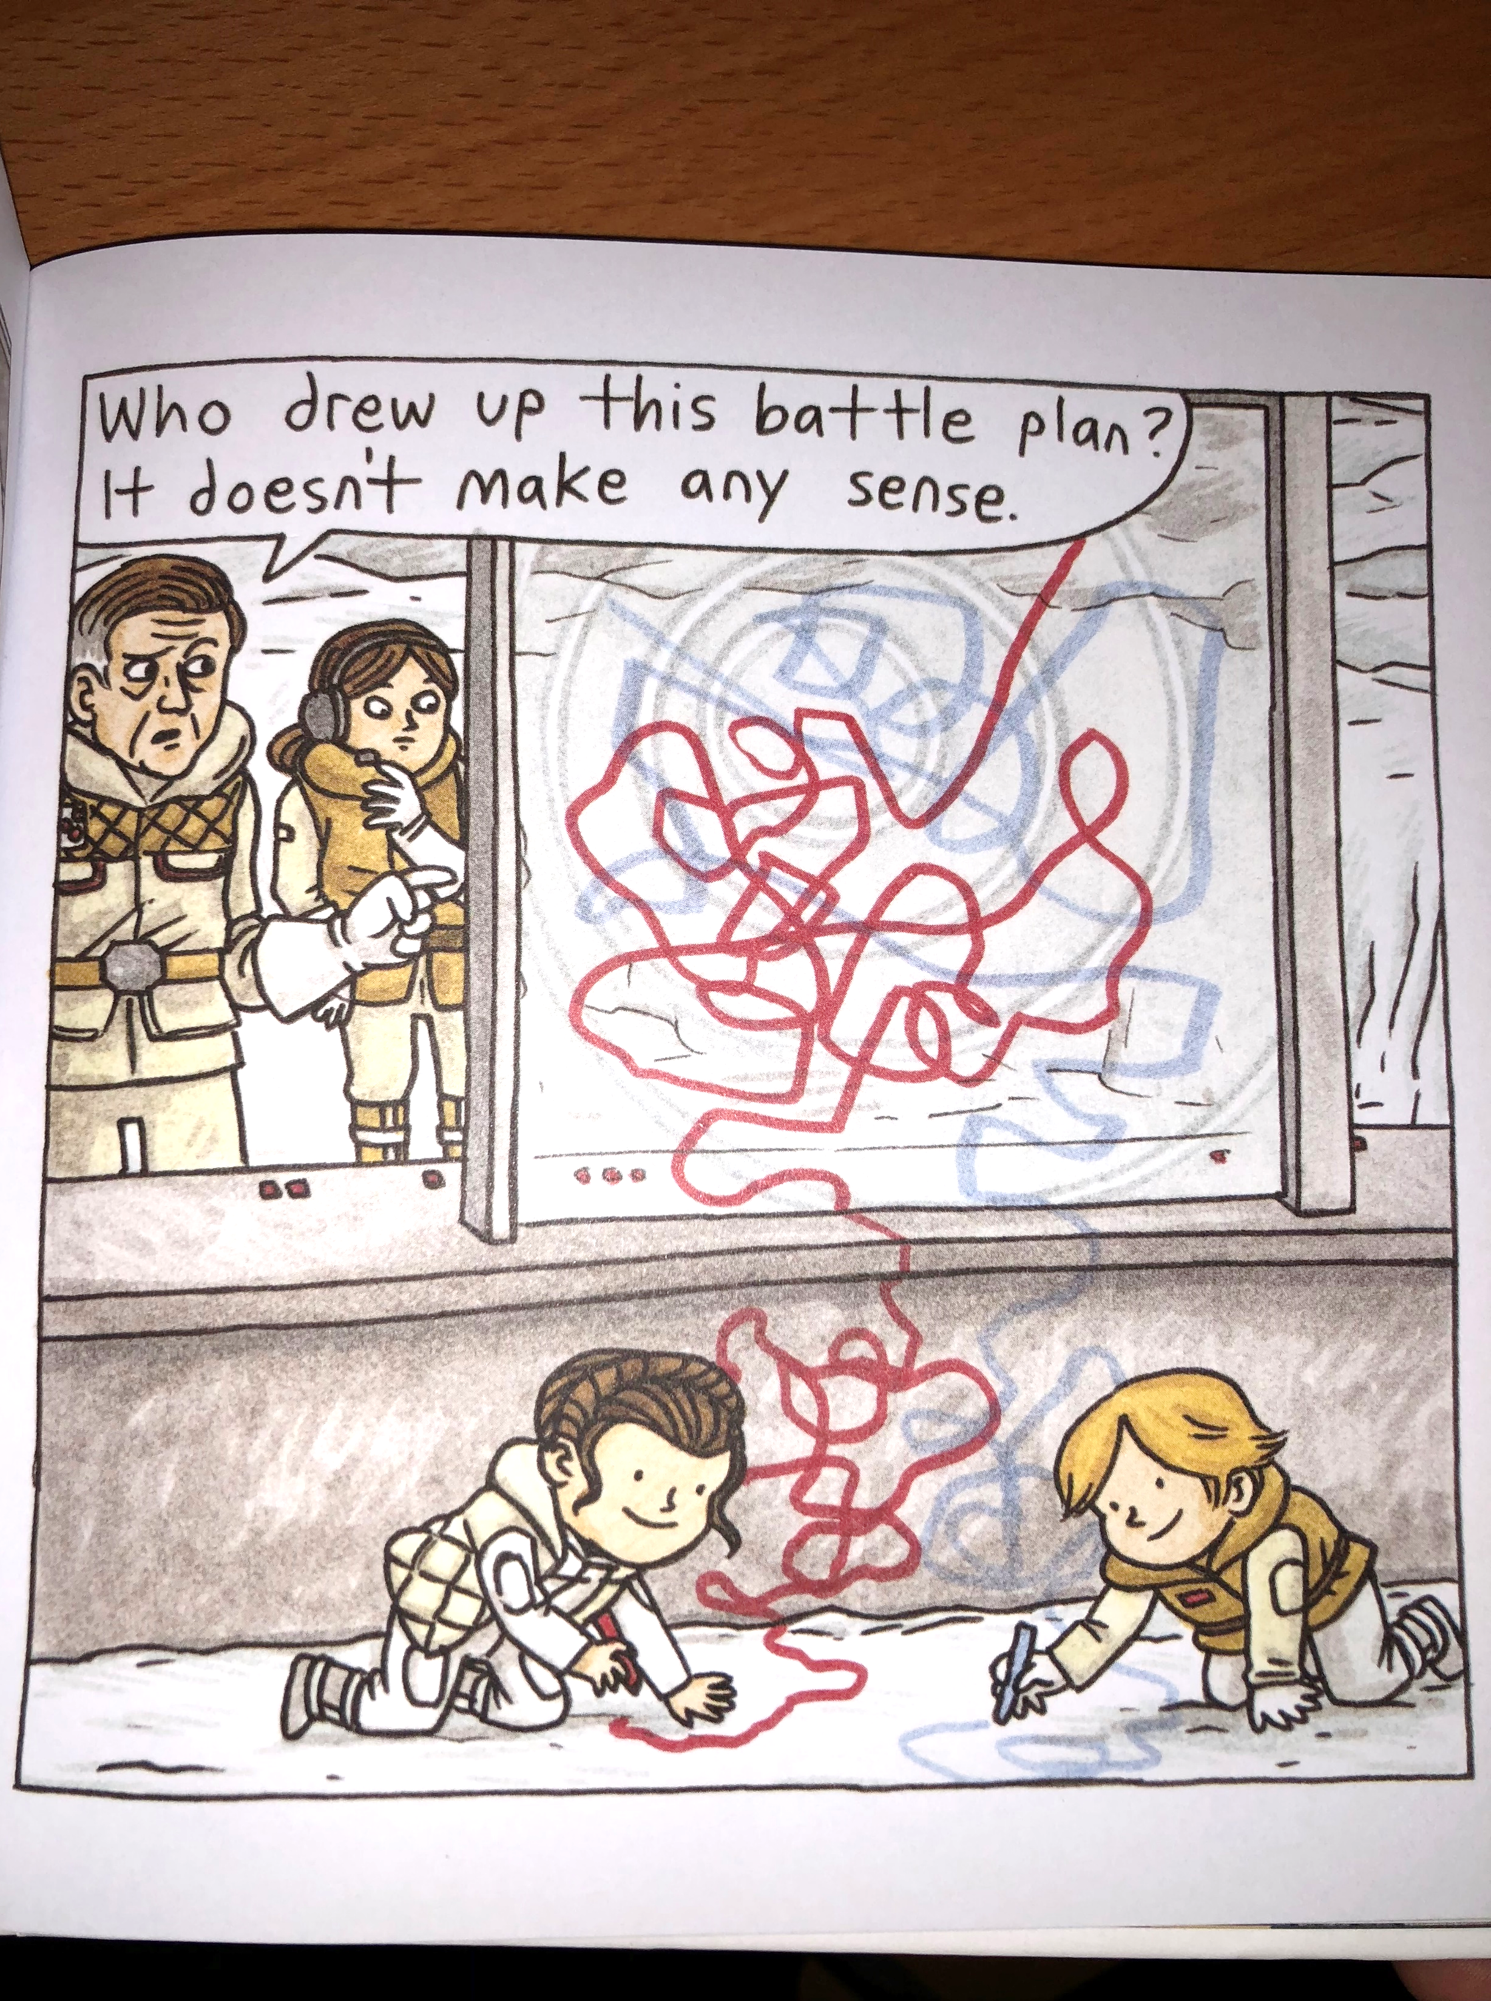

Slide 38
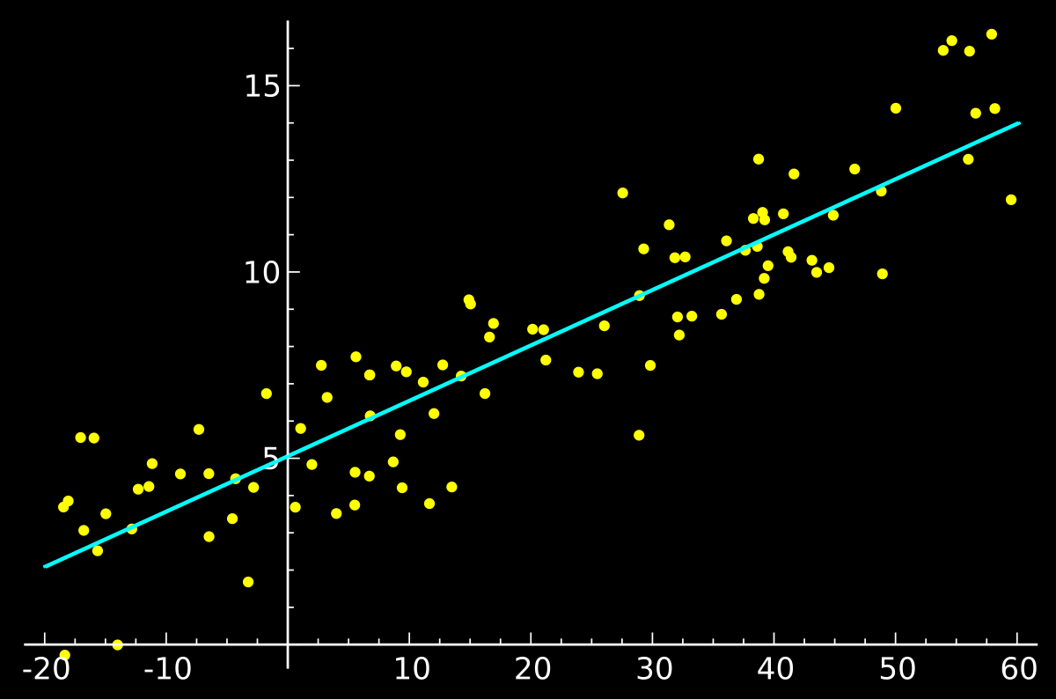
y = mx + b

Slide 39
Differentiation

Slide 40
High-Dimensional Numbers

Slide 41
High-Dimensional Vectors

Slide 42
High-Dimensional Arrays

Slide 43
0.3200 | 0.5421 | 0.5110 | 0.7389 | 0.4918 | 0.9184
0.8660 | 0.3020 | 0.4890 | 0.6987 | 0.3051 | 0.4029
0.0722 | 0.6375 | 0.7953 | 0.1546 | 0.2867 | 0.9654
0.3608 | 0.6891 | 0.8220 | 0.0024 | 0.2030 | 0.1865
0.6227 | 0.2532 | 0.9418 | 0.8587 | 0.0778 | 0.5965
0.1612 | 0.2107 | 0.1784 | 0.5981 | 0.5417 | 0.3071
0.2835 | 0.8236 | 0.3139 | 0.1868 | 0.7756 | 0.1203
0.5113 | 0.8758 | 0.0920 | 0.9075 | 0.1681 | 0.7669
0.6540 | 0.9847 | 0.2407 | 0.0232 | 0.4423 | 0.8521
0.1045 | 0.6293 | 0.9488 | 0.3950 | 0.5043 | 0.7875
0.0377 | 0.1511 | 0.6241 | 0.1502 | 0.2732 | 0.9331
0.2222 | 0.6622 | 0.5402 | 0.7650 | 0.1721 | 0.3517
0.4795 | 0.8597 | 0.4049 | 0.7070 | 0.0784 | 0.6631
0.3131 | 0.7966 | 0.4261 | 0.7823 | 0.7319 | 0.0807
0.2659 | 0.7687 | 0.7874 | 0.8179 | 0.0292 | 0.4352
0.4201 | 0.2091 | 0.2931 | 0.3404 | 0.4661 | 0.6139
0.3099 | 0.1022 | 0.0893 | 0.3600 | 0.8400 | 0.5494
0.0287 | 0.7979 | 0.6785 | 0.1231 | 0.0385 | 0.0082
0.5974 | 0.5917 | 0.1183 | 0.8901 | 0.9990 | 0.8012
0.7279 | 0.8426 | 0.2705 | 0.7502 | 0.9465 | 0.5517
0.9324 | 0.1228 | 0.4561 | 0.0281 | 0.7467 | 0.2544
0.9296 | 0.9581 | 0.9300 | 0.1107 | 0.0081 | 0.5787
0.0548 | 0.6564 | 0.0637 | 0.5374 | 0.1792 | 0.4786
0.3202 | 0.4883 | 0.9120 | 0.7424 | 0.8177 | 0.8120
0.8694 | 0.7283 | 0.8922 | 0.2756 | 0.9849 | 0.4665
0.2098 | 0.9957 | 0.5271 | 0.7638 | 0.4820 | 0.9617
0.2385 | 0.8299 | 0.3855 | 0.9500 | 0.3676 | 0.2845
0.1923 | 0.7167 | 0.6323 | 0.9345 | 0.2605 | 0.0331
0.5322 | 0.1652 | 0.4930 | 0.2563 | 0.5717 | 0.1103
0.7212 | 0.4764 | 0.9196 | 0.6196 | 0.4345 | 0.6993
0.8939 | 0.5753 | 0.7510 | 0.1955 | 0.7078 | 0.9869
0.9766 | 0.7216 | 0.0188 | 0.8569 | 0.8033 | 0.7709
0.3885 | 0.6761 | 0.4612 | 0.8000 | 0.8435 | 0.8812

Slide 44
0.1489
0.0026
0.0128
0.0731
0.1212
0.0933
0.0110
0.0011
0.0432
0.0002
0.0299
0.0054
0.0255
0.0035
0.1043
0.1407
0.0958
0.0060
0.0008
0.0417
0.0002
0.0389
35% | SwiftFest Logo
24% | Swift Logo
12% | Bird

Slide 45
Conv2D MaxPool ReLU Sigmoid TanH LSTM GRU

Slide 46

Code
Caffe
Data
2013

Slide 48

Code
Caffe
Data
2012
2015

Slide 49
Model as Data Structure Model as Code

Slide 50
Automatic Differentiation

Slide 51

Code
Caffe
Data
2012
2015
2016

Slide 52

Code
Caffe
Data
2012
2015
2016

Slide 53


Slide 54
File Specification API Conversion Tools

Slide 55
ProtoBuf
apple.github.io/coremltools/coremlspecification

Slide 56
Feature Engineering

Slide 57

Input Conversion
Execution
Metal
Output Conversion
35% | SwiftFest Logo
24% | Swift Logo
12% | Bird

Slide 58
MLModel VisionKit NSLinguisticTagger GameplayKit

Slide 59
VNRequest

Slide 60
VNCoreMLRequest

Slide 61
VNClassificationObservation

Slide 62
MLModel.compile(url:)

Slide 63
DictionaryFeatureProvider

Slide 64
let c = MLModel.compile(url: u)
let m = MLModel(url: c)
let d:[String:Any] = [“input”: image]
let dfpin = MLDictionaryFeatureProvider(dictionary: d)
let fp = m.predict(dfp)
let dfpout = fp.featureValue(for: “labels”)
let dic = dfpout.dictionaryValue
let topResult = dic.first()

Slide 65
MLMultiArray

Slide 66
Input Conversion
Execution
Metal
MLMultiArray

Slide 67
MLMultiArray
Execution
Metal
Output Conversion
35% | SwiftFest Logo
24% | Swift Logo
12% | Bird

Slide 68
let m = MLModel(url: c)
let d:[String:Any] = [“input”: image]
let dfpin = MLDictionaryFeatureProvider(dictionary: d)
let fp = m.predict(dfp)
let c2 = MLModel.compile(url: u2)
let m2 = MLModel(url: c2)
let fp2 = m2.predict(fp)
let dfpout = fp2.featureValue(for: “labels”)
let dic = dfpout.dictionaryValue
let topResult = dic.first()

Slide 69
Bottlenecking

Slide 70
Composition

Slide 71
Packaging

Slide 72
Code
Caffe
Data
Time

Slide 73
Python
Bindings
C Runtime

Slide 74
Object-Oriented Interpreted

Slide 75


Slide 76
Python
Compiler & Runtime
Bindings
C Runtime

Slide 77
import Python
let np = Python.import("numpy")
let gzip = Python.import("gzip")

Slide 78
Automatic Differentiation

Slide 79
@differentiable

Slide 80
@differentiable(reverse, adjoint: dTanh)
func tanh(_ x: Float) -> Float {
// ... some super low-level assembly…}
func dTanh(x: Float, y: Float, seed: Float) -> Float {
return (1.0 - (y * y)) * seed
}
// Get the gradient function of tanh.
let dtanh_dx = #gradient(of: tanh)
dtanh_dx(2)

Slide 81
// Get the gradient function of foo with respect to the first parameter.
let dfoo_dx = #gradient(of: foo, withRespectTo: .0)
dfoo_dx(3, 4)

Slide 82
Eager Execution

Slide 83
Composition

Slide 84



Code
Caffe
Data
Time

Slide 87
Thank You
github.com/rhdeck/swiftfest-2018

